Slide 1
LAOBOUR ANALGESIA
PROF.DR.M.BALASUBRAMANI
ASSOCIATE PROFESSOR, GTMCH THENI

Slide 2
Does Labor Pain Need Analgesia?
Labor pain ranked high on pain rating scale compared to other painful life experiences

Slide 3
Analgesia for Labor and Delivery
Always controversial!
“Birth is a natural process”
Women should suffer!!
Concerns for mother’s safety
Concerns for baby
Concerns for effects on labor

Slide 5
Cervical dilatation in stages

Slide 7
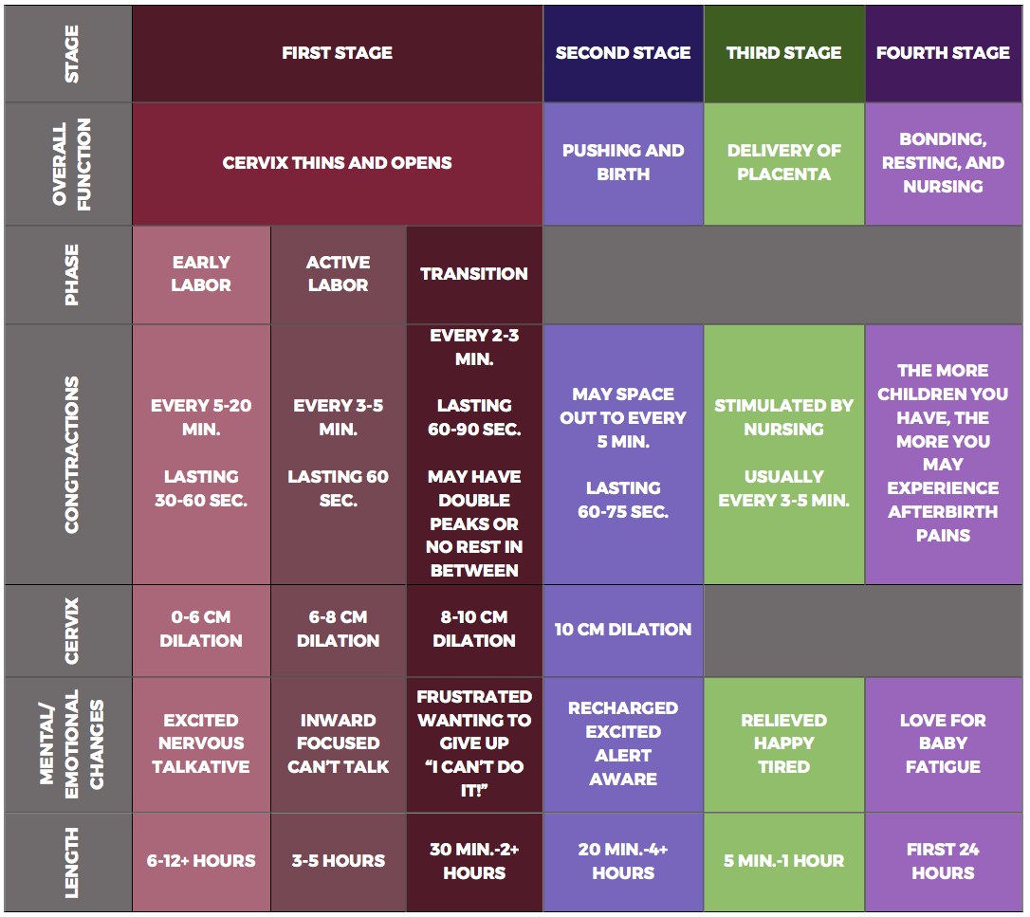

Slide 8
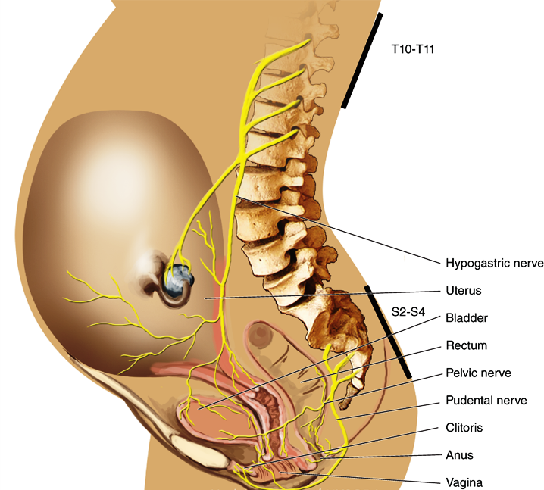
1st stage of labor
PAIN OF CHILDBIRTH
Mostly visceral
Dilation of the cervix and distention of the lower uterine segment
Dull, aching and poorly localized
Slow conducting, visceral C fibers,
Enter spinal cord at T10 to L1
2nd stage of labor
Mostly somatic
Distention of the pelvic floor, vagina and perineum
Sharp, severe and well localized
Rapidly conducting A-delta fibers,
Enter spinal cord at S2 to S4

Slide 12
Exhaustion and pain of labor can result in failure of progression of labor

Slide 13
REGIONAL
Hydrotheraphy
PARENTEREL OPIOID ANALGESIA
TENS
INHALATIONAL ANALGESIA
ACUPUNCTURE, ACUPRESSURE
PATIENT CONTROLLED ANALGESIA

Slide 14
V
V

Slide 15
Neuraxial labor analgesia
Only technique that can completely relieve the pain
during labor
GOLD STANDARD FOR
LABOR ANALGESIA
Pain relief and overall satisfaction with the birth experience- Greater

Slide 16
Central neuraxial analgesia ?
Predictable
Consistent degree of success
Total pain relief for both stages of labor
High degree of success rate
Gold standard technique
Safety record

Slide 17
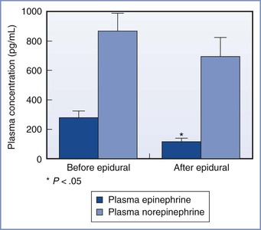
BENEFITS OF LABOR ANALGESIA
Effective epidural analgesia reduces maternal plasma concentrations of catecholamines
Influence of epidural analgesia on maternal plasma concentrations of catecholamines during labor. *P < .05 compared with before initiation of epidural analgesia. (Modified from Shnider SM, Abboud TK, Artal R, et al. Maternal catecholamines decrease during labor after lumbar epidural anesthesia. Am J Obstet Gynecol 1983; 147:13-5.)

Slide 18
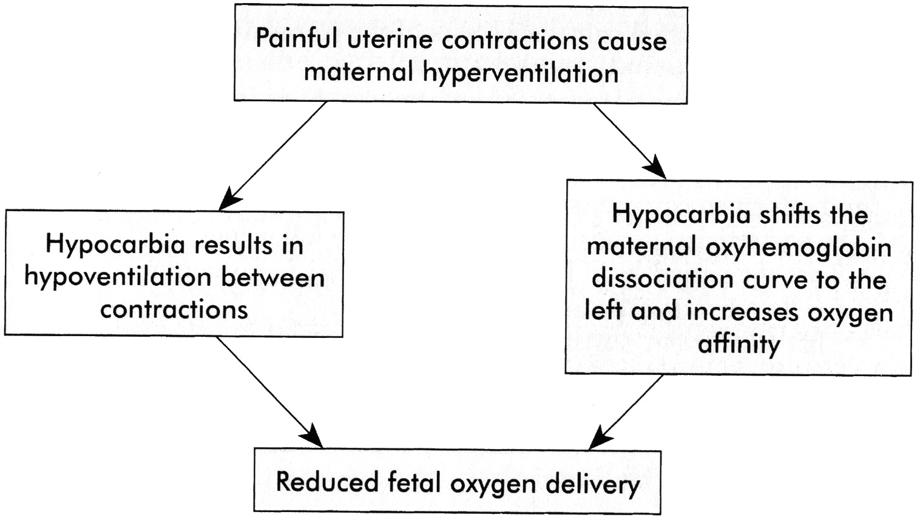
BENEFITS OF LABOR ANALGESIA
Blunts this“Hyperventilation- Hypoventilation” cycle

Slide 19
TO Whom?
In 2008 and in 2010, ACOG and ASA jointly
made a statement that
“in the absence of medical contraindication maternal request is a sufficient medical indication for pain relief during labour”.

Slide 20
TO Whom?
Obstetric
Vaginal breech
Vaginal twins
Preeclampsia
Medical Conditions
Valvular heart disease

Slide 21
Contraindication
Refusal
Hypotension
Coagulopathy
Cardiac failure
Infection
Gross spine deformity
↑ICT
Inadequate resources (e.g., staff, equipment) for monitoring and resuscitation

Slide 22
Neuraxial labor analgesia- what is safe practice?
Antenatal consultation and planning
Full co-operation from obstetric team
Complete history/ data of Mother and Foetus
Examination of the patient
Obstetric and medical management/Satisfaction
Anaesthetic team, equipments and technique
-No compromise

Slide 23
TECHNIQUES OF Neuraxial block
Continuous epidural analgesia (CE)
Combined spinal-epidural analgesia (CSE)
Dural puncture – CE
Continuous caudal epidural
Intermittent epidural bolus injections
Basal flow with intermittent bolus
Patient-controlled epidural analgesia (PCEA)
Spinal
Continuous spinal analgesia

Slide 24
Choice of Drugs
Local anaesthetics
Bupivacaine
Most commonly used agent for epidural labor analgesia.
Highly protein bound, limits trans-placental transfer.
After epidural administration
Initiation - 8 to 10 minutes
peak effect - 20 minutes
Duration of analgesia - 90 minutes.
Ropivacaine
Levo bupivacaine
Lidocaine
2-chlorprocaine

Slide 25
Choice of Drugs
Opioids
Lipid-Soluble Opioids
Fentanyl
Sufentanil
Advantages
decreases latency,
prolongs the duration of analgesia,
decreases epidural LA requirement ,
decreases motor blockade and
improves the quality of analgesia.
Alfentanil,Morphine,Meperidine,Butorphanol, Diamorphine

Slide 26
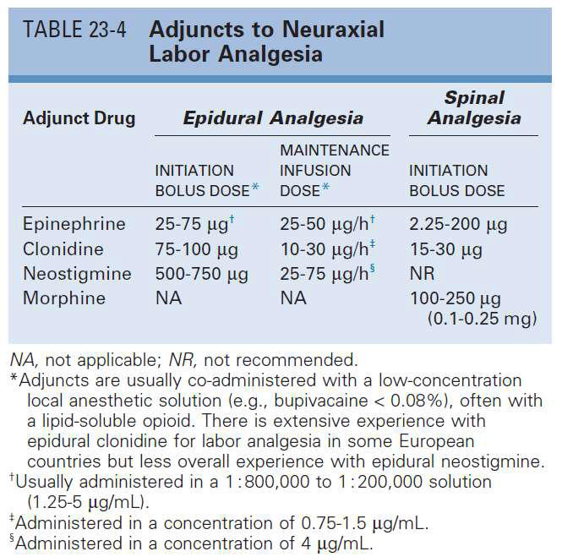
Adjuvants
Epinephrine
Clonidine
Neostigmine

Slide 27
Initiation of labor analgesia
Drug | Epidural Analgesia | Spinal Analgesia
Bupivacaine | 0.0625% 10ml bolus 0.125% 5ml increment after 15 min | 1.25-2.5 mg
Ropivacaine | 0.08% 10-12 ml bolus 0.2% 5ml increment after 15min | 2.5-3.5 mg
Levobupivacaine | 0.0625% 10 ml bolus 0.125% 5 ml increment after 15 min | 1.25-2.5 mg
Lidocaine | 0.75%-1.0% 10 ml bolus | -------
Fentanyl | 50-100 μg | 15-25 μg
Sufentanil | 5-10 μg | 1.5-5 μg

Slide 28
MAINTENANCE OF EPIDURAL ANALGESIA
Intermittent bolus injections
Continuous epidural infusion
Patient Controlled Epidural Analgesia (PCEA)
Computer Integrated Patient Controlled Epidural Analgesia (CI-PCEA)
Programmed intermittent epidural boluses (PIEB)
Drugs
Dilauted LA – 8-15 ml/hr with
Fentanyl 1.5-3 mcg/ml (or) Sufentanyl 0.2-0.4 mcg/ml

Slide 29
Choosing the neuraxial block
Well before labour pain
Continuous Epidural(CE)
Labour pain just started
CE/ CSE
First stage of labour
CE/ CSE
Second stage of labour
SPINAL / CSE

Slide 30
Epidural catheter placement
Dural Puncture (0.5-3% incidence)
Intravenous placement (3-15%)
Aspiration of blood or CSF is quite reliable
Test dose to confirm the position

Slide 31
Test dose
Lignocaine 45 mg and epinephrine 15µg injected through the catheter. (40mg&10µg)
A raise in heart rate by 20 beats with in 45 seconds -intravascular
Undue rapid motor paralysis –subarachnoid

Slide 32
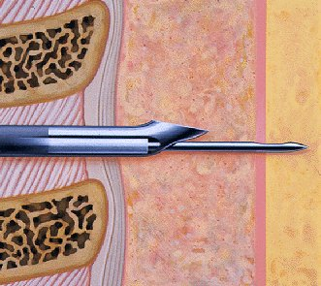
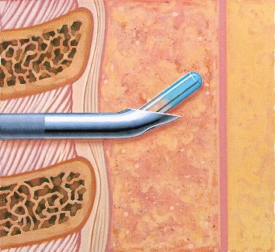
CSE Needle through Needle

Slide 33
Advantages of CSE
Rapid onset
Long duration
Easy to administer
No side effects on mother
No side effects on baby
No effect on length of labor or mode of delivery
Better patient satisfaction
Aids in epidural localization in difficult backs
Faster cervical dilation in early nulliparas
Side effects are acceptably low

Slide 34
Failure of CSE
A. Spinal needle tents the dura Doesnot puncture
B. Spinal needle doesnot reach the dura
C. Spinal needle passes to the side of the dura

Slide 35
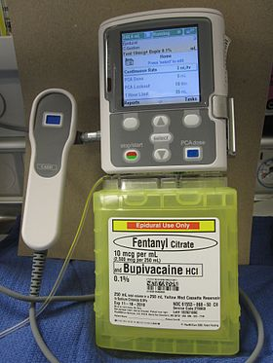
Patient controlled Epidural Analgesia (PCEA)

Slide 36
WALKING EPIDURAL
Adding opioids ↓ Motor Block
“Walking” epidurals: ↓ Motor Block meant better outcomes
No evidence of improved labor pattern/outcome with ambulation
Women don’t walk even if they can
Monitoring problems
Always supported
DO NOT ALLOW THEM TO WALK

Slide 37
Computer Integrated- Patient Controlled Epidural Analgesia (CI-PCEA)
A laptop computer with a programed algorithm is connected to a standard epidural pump
The computer program automatically adjusts the background infusion rate based on the analysis of patient’s L.A. requirement in the last one hour
lesser incidence of breakthrough pain and increased maternal satisfaction.

Slide 38
Computer Integrated- Patient Controlled Epidural Analgesia (CI-PCEA)

Slide 39
Programmed intermittent epidural boluses

Slide 40
Programmed intermittent epidural boluses

Slide 41
MYTHS
MYTHS / CONTROVERSIES | EVIDENCE
Increased incidence of Cesarean Delivery | Initiation of neuraxial analgesia, even in the latent phase of labor (cervical dilation <4 cm) does not increase the risk of Cesarean delivery[80]
Increased incidence of instrumental vaginal delivery | Outcome is affected by multiple confounding factors (e.g. degree of analgesia during second stage of labour, L.A concentration, method of epidural analgesia maintenance, neuraxial analgesic technique, obstetric factors)[80]
Wang F, Shen X, Guo X, Peng Y, Gu X, Labor Analgesia Examining Group. Epidural analgesia in the latent phase of labour and the risk of cesarean delivery: A five-year randomized
controlled trial. Anesthesiology 2009;111:871-80.

Slide 42
MYTHS
MYTHS / CONTROVERSIES | EVIDENCE
Increased duration of first stage of labor | Conflicting evidence. Overall evidence from literatures suggests no difference in the duration of the first stage of labour
Halpern SH, Leighton BL. Epidural analgesia and the progress of labour. In: Halpern SH, Douglas MJ, editors. Evidence-based obstetric anesthesia. Oxford: Blackwell;
2005. p. 10-22

Slide 43
ACOG jointly with ASA- 2013
Epidural Labour analgesia
1. NO increase the rates of cesarean
2. NO difference in rate of cesarean compared with intravenous analgesia.
3.No difference in the incidence of cesarean carried out early or late in labour
At the claimed low local anaesthetic concentration with opiods- Epidual/SAB

Slide 44
Epidural Complications
Early
IV toxicity
LA toxicity
Hypotension
High block/total spinal
Extensive motor block
Fetal effects
Urinary retention
Late
PDPH
Neurological injury
Epidural abscess
Epidural hematoma
Back pain?

Slide 45
Future of labor analgesia
Ultra‑low‑dose (<0.1%) local anesthetic–opioid solutions with PCEA and PIEB pumps allowing more flexibility
Ultrasound‑guided neuraxial blocks in difficult cases
Novel LOR methods
Epidrum
Episure –Auto detect syringe
Epifaith syringe
Novel epidural needles - Three optical fibers are embedded in Tuohy needle shaft

Slide 46
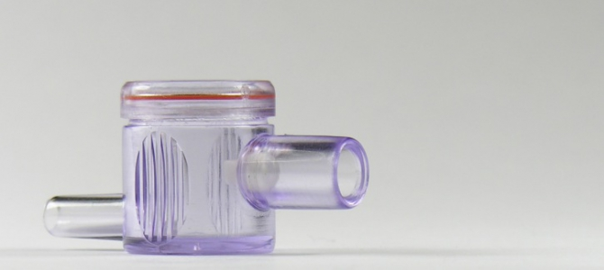
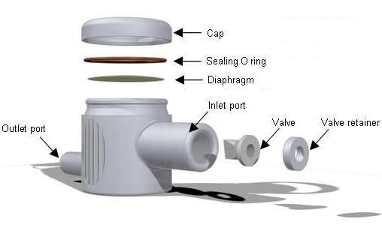
EPIDRUM

Slide 47
EpiFaith syringe

Slide 48
Episure –Auto detect syringe

Slide 49
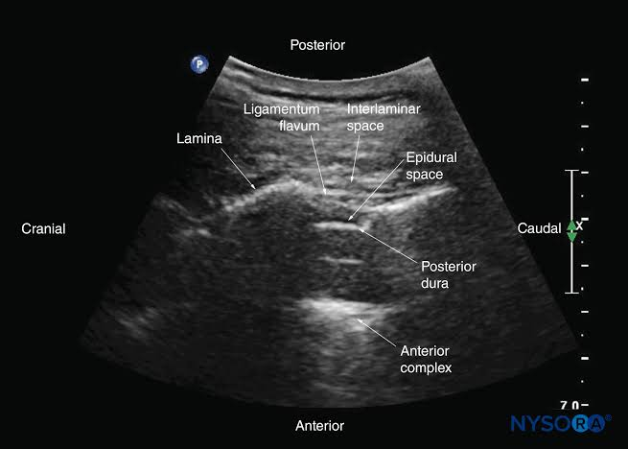
USG GUIDED NEURAXIAL TECHNIQUES

Slide 50
USG GUIDED NEURAXIAL TECHNIQUES

Slide 51
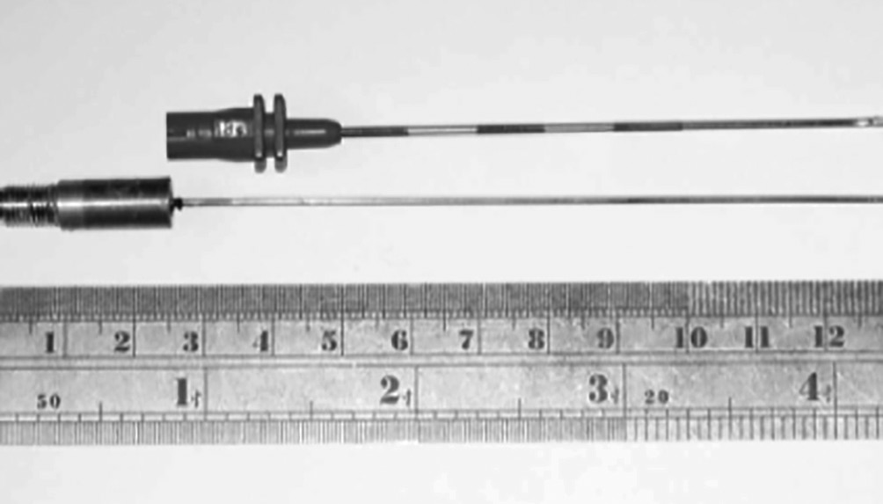
Novel epidural needles
Three optical fibers are embedded in Tuohy needle shaft
OPTICAL FIBRE SITES

Slide 52
“The delivery of the infant into the arms of a conscious and painfree mother is one of the most exciting and rewarding moments in medicine”
THANK YOU

